Slide 1
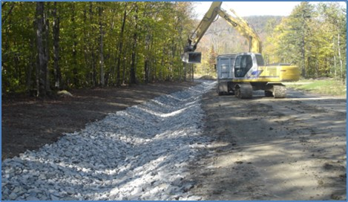
Town Road Access and Drainage
Milly Archer
Water Resources Coordinator

Slide 2
Municipal Road General Permit
Addresses stormwater run-off from “hydrologically connected” municipal roadway segments (100 meters/328 ft.)
Requires towns to implement customized, multi-year plans to stabilize road drainage systems
Jurisdiction is limited to the municipal road right-of-way.
Does not address private roads
Notes:
Hydrologically connected means: For paved roads with catch basins – the outfall pipe is within 500 feet of surface water. For all other roads -Within 100 feet of surface water or the road bisects surface water, or the road segment is uphill and drains to a road that bisects a surface water.

Slide 3
Highway Access Drainage Management
MRGP does not address “run on” into the municipal road ROW from adjacent lands
Poorly constructed driveways and private access roads can cause road damage to town roads and contribute to stormwater pollution.
It is important for towns to review highway access requirements to make sure drainage into the ROW is addressed.
Notes:
It’s important to determine if stormwater damage is caused from drainage form adjacent lands, including driveways and private roads.
Who is responsible to solve the drainage issue? How can it be enforced?

Slide 4
Title 19 V.S.A. § 1111(b)
Requires all individuals and corporations to obtain a permit to occupy or alter any part of a municipal right-of-way
Access permit requirements may be found in the form of a policy, or in an ordinance, zoning, subdivision or they may be informal.
(Sec. 1111(a), directs the state to require permits for access onto state highways.)
Notes:
Authorizes and directs towns to require individuals to obtain a permit to occupy or alter any part of the municipal ROW.
Often referred to as an “access permit” or a “curb cut.”
Access permits are required when driveways or private roads intersect with public highways.

Slide 5
Title 19 V.S.A § 1111(b) Driveway entrances, highway grades; drainage
“. . . It shall be unlawful to develop, construct, re-grade, resurface or fill or grade the land adjacent to a highway . . . so as to divert the flow of water onto the highway right-of-way without a permit from the agency, in the case of state highways, or the legislative body of a municipality or designee of a municipality, in the case of town highways.”
Notes:
Here’s the language taken out of Title 19 V.S.A. 1111(b). Access permit requirements may be found in the form of a policy, or in an ordinance, zoning, subdivision or they may be informal.

Slide 6
Culverts and driveway access “curb cut” permits
Title 19 V.S.A § 1111(b) authorizes towns to set forth standards and conditions that must be complied with before an access (curb cut) permit may be issued
Must protect safety of traveling public
Must maintain reasonable levels of service
Must protect the public investment in the existing infrastructure
Notes:
Traditionally these policies and ordinances have been focused of safety to the traveling public, maintaining a reasonable level of service, and protecting the public investment.

Slide 7
Driveway and Private Road Access Policies and Ordinances
Establish minimum standards for access design, construction and maintenance
Useful tool for:
controlling drainage
mitigating erosion
decreasing maintenance, saving money and time
Can require property owners to compensate the town for expenses for restoring public road if damages are caused by improper construction, maintenance or grading of an access point
Notes:
It is important to take a look at your driveway and private road access design and construction standards. They can be a useful tool to help control drainage and erosion, which will decrease the amount of maintenance required and save time and money.

Slide 8
Damage to Town Highways
“In the event that damage to a town highway is caused by improper construction, maintenance, or grading of a driveway or other highway access point, it shall be the responsibility of the property owner to compensate the Town for any expenses involved in restoring that highway to its original condition.”
VLCT Municipal Assistance Center Model Town Highway Access Policy
Notes:
Driveway and private road access policies and ordinances can require property owners to compensate the town for expenses for restoring the public road if damages are caused by improper construction, maintenance or grading of an access point.

Slide 9
VLCT Model Town Highway Access Policy & Drainage Mgt. Standards
The VLCT Municipal Assistance Center has recently developed:
Model Access Policy
Model Access Forms
Access Permit Application
Notice of Permission to Proceed
Access / Right-of-Way Permit
Sample Stormwater Drainage Management Standards for Town Highway Access Policies
Notes:
The VLCT Municipal Assistance Center has recently developed a Model Access Policy, Model Access Forms and Sample Stormwater Drainage Management Standards for Town Highway Access Policies.

Slide 10
Access Management reference standard sheets
VTrans A-76 Standards for Town & Development Roads
VTrans B-71 Standards for Residential and Commercial Drives
“When issuing a Notice of Permission to Proceed, the Selectboard shall require that the proposed access will be constructed or developed according to VTrans Standards B-71 and A-76.”
VLCT Municipal Assistance Center
Model Town Highway Access Policy
Notes:
The VLCT Model Access Policy references the Vtrans Standards A-76 for development roads and B-71 Standards for residential and commercial drives.

Slide 11
Sample Stormwater Drainage Management Standards
Culvert Size
Design and Installation of Culverts
Ditches and Slopes
Drainage Outlets and Turnouts
Surface Materials and Road Crowning
Approaches to Public Roads
Soil Disturbing Activities and Bank Stabilization
Purpose: to help towns accomplish the erosion prevention requirements imposed by the MRGP by addressing drainage into the public right-of-way.
Notes:
The Sample Stormwater Drainage Management Standards for Town Highway Access Policies are organized by the following topics . . . With the purpose of helping towns accomplish the erosion control requirements imposed by the MRGP by addressing drainage into the public ROW.

Slide 12
Drainage Management Standards reference documents
Vermont DEC Municipal Roads General Permit – VTDEC, January 2018
Intermittent Stream Culvert Sizing Guidance – VTDEC, January 2018
Developing a Highway Access Policy – Vermont Local Roads Program (VLR), 1997
Town Road and Bridge Standards – VTrans Orange Book, Section 7, April 2017
Access Management Program Guidelines – VTrans, 2005
Vermont Better Backroads Manual – George D. Aiken & Northern Vermont Resource Conservation and Development Councils, 2009
Notes:
The sample drainage management standards were developed from information provided by state agencies and the Vermont Local Roads Program before it became part of Vtrans.

Slide 13
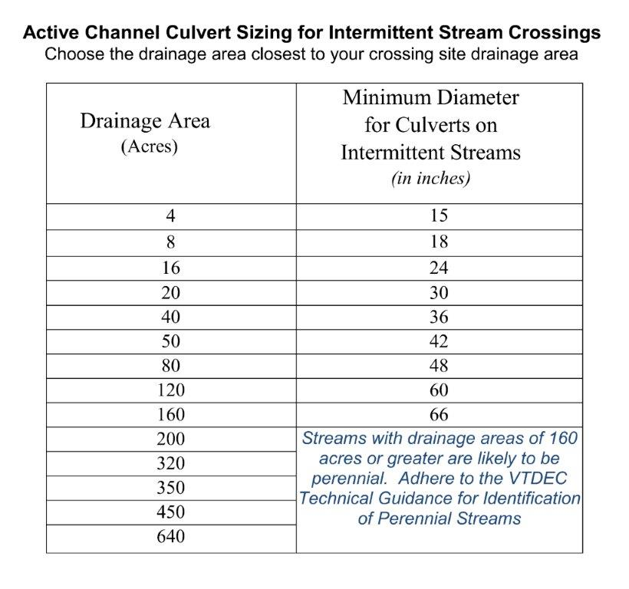
Sample Access Standard VTDEC Culvert Sizing Guidance
Notes:
The next few slides give you and idea of how the sample drainage management standards can be incorporated into the town highway access policy. This first one is culvert sizing guidance based on the size of the drainage area from VTDEC Rivers program.

Slide 14
Sample Access Standard Ditches and Slopes
Driveway and private access road ditches with slopes 0% to 5% shall at a minimum be grass-lined with no bare soil. Geotextile and erosion matting may be used instead of seed and mulch.
Driveway and private access road ditches with slopes 5% to 8% shall be stone-lined with 6” – 8” minus stone, grass-lined with stone check dams, or grass-lined with disconnection practices such as cross culverts or turnouts to reduce runoff volume.
Driveway and private access road ditches with slopes greater than 10% shall be stone-lined with 12” minus stone or the equivalent.
Notes:
Based on the slope of the ditch, same standards reflected in the MRGP, more specific than the Vtrans Town Road Standards, (by specifying stone size), more lenient for ditches with slopes 5% to 8%, in that they can still be grass lined if they have turnouts to reduce runoff volume.

Slide 15
Sample Access Standard Drainage Outlets
All drainage ditches shall be turned out to avoid direct outlet to surface waters.
Turnouts onto slopes 0% to less than 5% shall, at a minimum, be stabilized with grass.
Turnouts onto slopes 5% or greater shall be stabilized with stone.
Notes:
The sample access standards for drainage outlets developed to avoid direct discharge into surface waters are the same as the MRGP standards. The Vermont Local Roads recommends that ditches along driveways be turned out onto the private property where it can be dispersed into vegetated areas.

Slide 16
The most recent version of the VTrans Town Road and Bridge Standards. . .
Culverts
Minimum driveway culvert – 15 inches
Minimum development road culvert – 18 inches
Culvert headwalls required where there is erosion
Ditches and Slopes
Ditches must be turned out to avoid direct outlet into surface waters
Ditch slopes less than 5% - seeded and mulched
Ditch slopes greater than 5% - stone lined
Driveways and roads crowned for water drainage
Notes:
This slide reflects the Vtrans Town Road and Bridge Standards regarding culvert sizing, ditch lining based on slope, culvert headwalls and turnouts. As you can see, these BMPs are very close to the standards that towns must meet under the MRGP.

Slide 17
Sample Access Standard Soil Disturbance and Bank Stabilization
Following construction and soil disturbance on driveways and access roads, all exposed areas shall be revegetated with seed and mulch, hydroseeded, or stone lined within 5 days of disturbance of soils.
All banks and slopes adjacent to driveways an private access roads shall at a minimum be stabilized by seeding and mulching.
In situations where banks will erode in spite of seeding the legislative body or designee may require other methods for stabilizing soils, such as the use of structural materials and woody plants.
Notes:
The MRGP emphasizes revegetating exposed areas following construction, so we added some sample access standard language to address stabilizing soils, banks and slopes.

Slide 18
Subdivision and/or Zoning Regulations
Town road access, driveway and development road standards can be included in zoning.
Subdivision or zoning can (and should) reference other adopted standards, such as the town’s road access policy or VTrans Town Road and Bridge Standards.
The Zoning Administrator can stipulate that the applicant obtain an access permit from the Selectboard before the zoning permit is valid.
Notes:
The primary avenue of municipal authority to regulate town road access, driveways and private roads, is in a highway access ordinance or policy. Sometimes driveway standards can be found in zoning or subdivision regulations. They should reference other adopted standards.

Slide 19
Document Consistency is important!
These documents all need to align and not conflict:
Town Highway access policy or ordinance
Town Road and Bridge Standards
Subdivision and Zoning Regulations
Maybe even Public Works Specifications (?)
Notes:
All municipal policies, standards, regulations, and specifications that cover driveways and private road requirement should all align and not conflict. It is probably a good idea to pic one document to specifically cover driveway and private road construction and reference the other adopted permit requirements to that one document.

Slide 20
If you have questions or need assistance, please contact:
Milly Archer
Water Resources Coordinator
VLCT – Municipal Assistance Center
(802) 229-9111
(800) 649-7915
marcher@vlct.org

